Slide 1
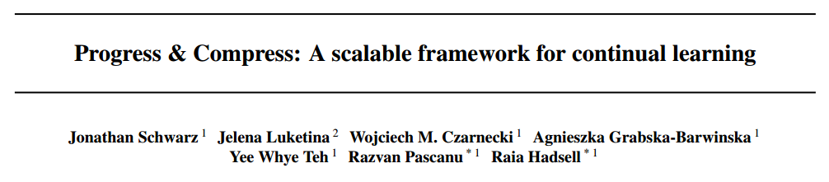
ICML 2018
Wenchao Chen

Slide 2
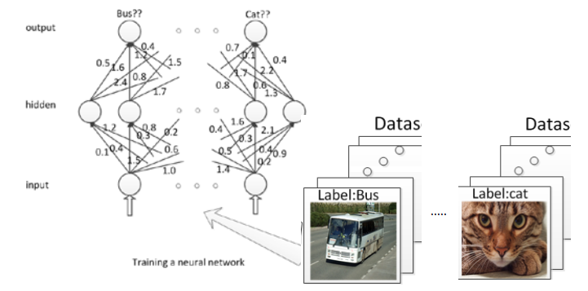
Continual learning
a very general form of online learning in which data continuously arrive in a possibly non i.i.d. way
Continual learning: lifelong learning, never-ending learning
Similar:
Online learning
Multitask learning
Transfer learning
Why continual learning?
Online multitask learning = continual learning
continual learning systems must adapt to perform well on the entire set of tasks in an online way that avoids revisiting all previous data at each stage
real world tasks continually evolve over time

Slide 3
The Progress and Compress framework
There are multiple, often competing, desiderata for continual learning
A continual learning method should not suffer from catastrophic forgetting.
It should be able to learn new tasks while taking advantage of knowledge extracted from previous tasks.
It should be trainable on a large number of tasks.
It should enable positive backwards transfer as well
It should be able to learn without requiring task labels

Slide 4
Continual learning
The way for continual learning:
Feature Extraction and Fine-tuning a pretrained model on a target domain
Introduce task-specific parameters
The use of episodic memory
Regularising learning

Slide 5

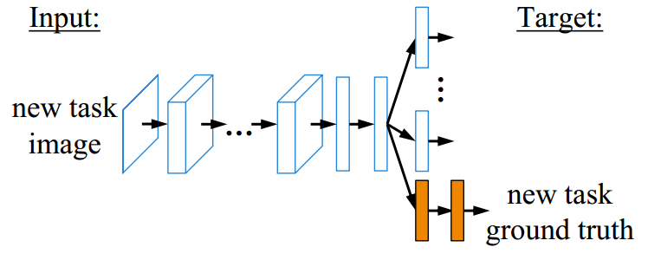
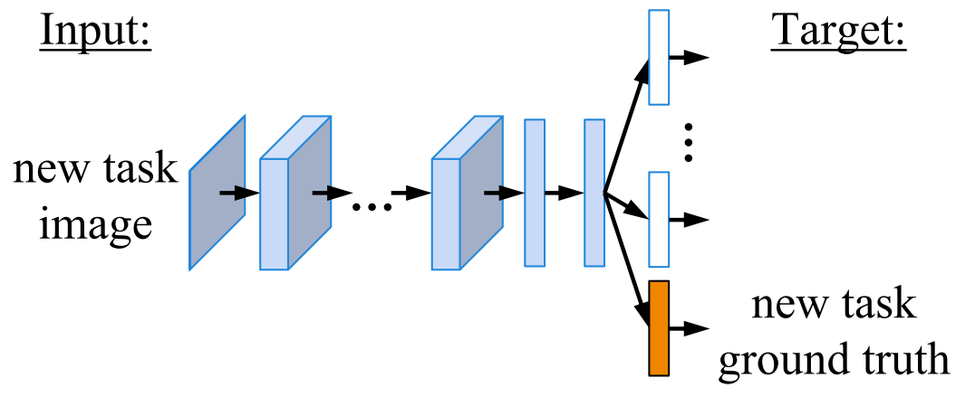
Feature Extraction and Fine-tuning
Feature Extraction
Only for similar task
Fine-tuning
Li, Zhizhong and Hoiem, Derek. Learning without forgetting. TPAMI 2017.

Slide 6
Feature Extraction and Fine-tuning
A continual learning method should not suffer from catastrophic forgetting.
It should be able to learn new tasks while taking advantage of knowledge extracted from previous tasks.
It should be trainable on a large number of tasks.
It should enable positive backwards transfer as well
It should be able to learn without requiring task labels

Slide 7
Continual learning
The way for continual learning:
Fine-tuning a pretrained model on a target domain
Introduce task-specific parameters
The use of episodic memory
Regularising learning

Slide 8
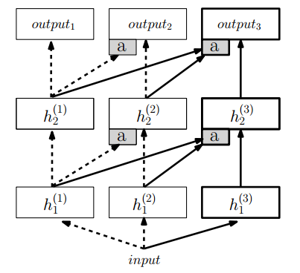


Progressive Neural Network
solve K independent tasks at the end of training
accelerate learning via transfer when possible
avoid catastrophic forgetting
Make no assumptions about the relationship between tasks, which may in practice be orthogonal or even adversarial
Rusu, Andrei A, Rabinowitz, etc Progressive neural networks.
arXiv preprint arXiv:1606.04671, 2016.

Slide 9
Introduce task-specific parameters
A continual learning method should not suffer from catastrophic forgetting.
It should be able to learn new tasks while taking advantage of knowledge extracted from previous tasks.
It should be trainable on a large number of tasks.
It should enable positive backwards transfer as well
It should be able to learn without requiring task labels

Slide 10
Continual learning
The way for continual learning:
Finetuning a pretrained model on a target domain
Introduce task-specific parameters
The use of episodic memory
Regularising learning

Slide 11
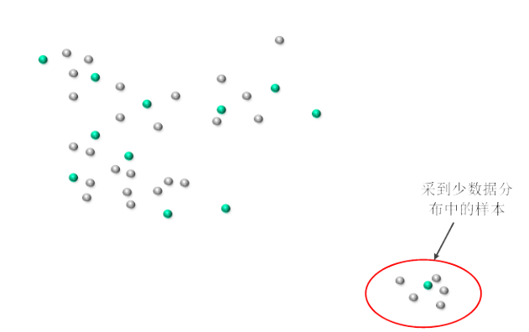
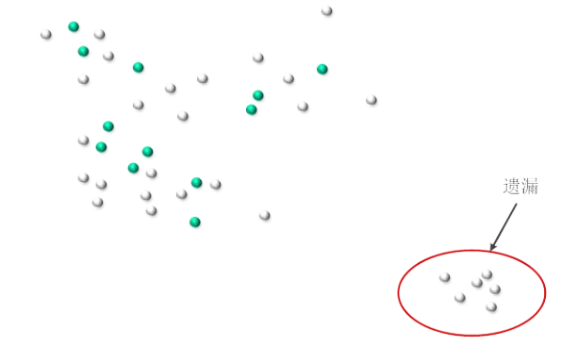
Using episodic memory
Coreset
:Coresets and Their Applications. Proceedings of the Spie, 2010,
Random sampling
Coreset
Gradient Episodic Memory for continual learning NIPS2017
Need to be stored in memory, which could quickly become a limiting factor in large scale problems!

Slide 12
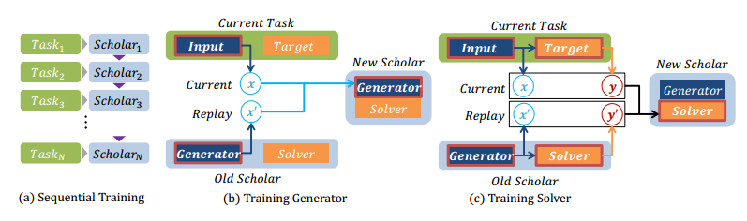
Using episodic memory
Continual Learning with Deep Generative Replay NIPS 2017
Training Generator:
Training Solver:

Slide 13
Using episodic memory
A continual learning method should not suffer from catastrophic forgetting.
It should be able to learn new tasks while taking advantage of knowledge extracted from previous tasks.
It should be trainable on a large number of tasks.
It should enable positive backwards transfer as well
It should be able to learn without requiring task labels

Slide 14
Continual learning
The way for continual learning:
Finetuning a pretrained model on a target domain
Introduce task-specific parameters
The use of episodic memory
Regularising learning

Slide 15
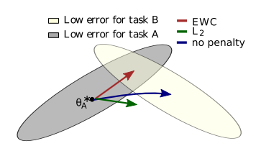

Elastic weight consolidation(EWC)
Overcoming catastrophic forgetting in neural networks. Proceedings of the National Academy of Sciences,2017
All the information about task A must therefore have been absorbed into the posterior distribution .
Approximate the posterior using the Laplace approximation
centred at the maximum a posteriori (MAP) parameter
when learning task i
So:
Shortcoming:
Laplace approximation
Point estimate
Regular item increase linearly
Task b:
Task c:

Slide 16
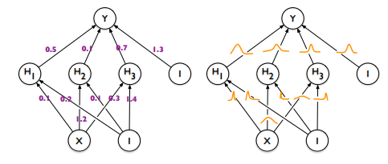
Variational Continual Learning(VCL)
Weight uncertainty +online VB
Weight uncertainty neural network
online VB
数据集
each weight has a fixed value
each weight is assigned a distribution
Variational Continual Learning Cuong V. Nguyen, Yingzhen Li,Thang D. Bui and Richard E. Turner
ICLR 2018

Slide 17


Variational Continual Learning(VCL)
Discriminate model:
Generative model(eg : VAE):
Regular item

Slide 18
Regularising learning
A continual learning method should not suffer from catastrophic forgetting.
It should be able to learn new tasks while taking advantage of knowledge extracted from previous tasks.
It should be trainable on a large number of tasks.
It should enable positive backwards transfer as well
It should be able to learn without requiring task labels

Slide 19
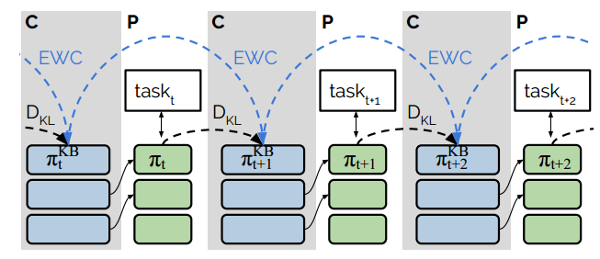
The Progress and Compress framework
ICML 2018
Main idea : unifying existent method in a framework that satisfies multiple desiderata, by taking advantage of their complementary strengths while minimising their weaknesses.
Key way: Progressive Neural Network + EWC
Two phases of learning
Learning a new task(progress phases)
Distillation and knowledge preservation(compress phases)
C: compress phases
P : progress phases
The two components are learnt in alternating phases

Slide 20

The Progress and Compress framework
Learning a new task
Knowledge base is fixed , active column(progress phases) is learnt without regularisation.
The ith layer of the active column is compute as:
is a trainable vector of size equal to the number of units in layer i.i.t is initalised by sampling from
Fine-tuning : similar tasks
re-initialising : diverse tasks

Slide 21
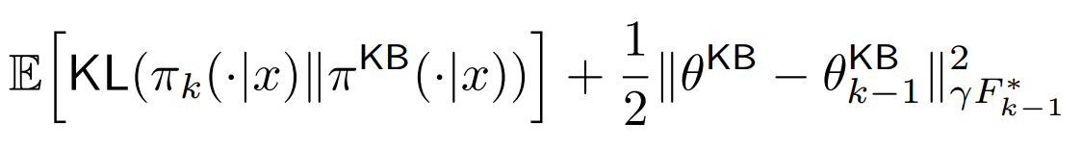
The Progress and Compress framework
Distillation : transfer the knowledge from a cumbersome model to a small model that is more suitable for deployment.
Minimizing the KL-divergence between the teacher’s (active column) and student’s (knowledge base) prediction/policy.
Knowledge preservation : rely on EWC
Distillation
Online EWC

Slide 22


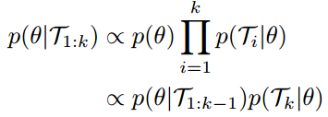

Online EWC
The problem of EWC :the number of regularisation terms grow linearly in the number of tasks, meaning that the original EWC algorithm is not scalable to a large number of tasks
“re-centred” at the latest MAP
parameter
Laplace’s approximation:
sum of the Fishers

Slide 23
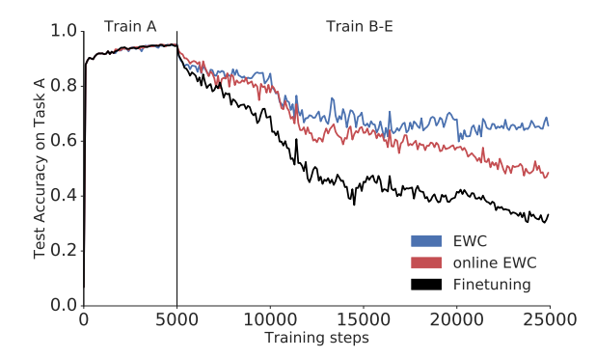
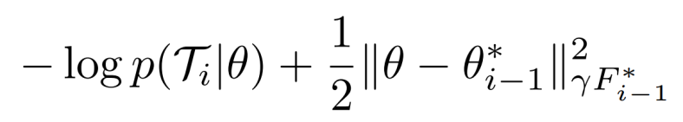
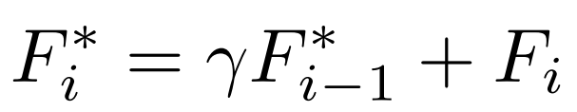
Online EWC
Shifting the mean to the latest MAP value will mean that older tasks will be remembered less well,
are the MAP parameter and overall Fisher after presentation of i-1 tasks
avoiding the need for identifying the task labels
via the γ down-weighting, explicitly forget older tasks in a graceful and controlled (rather than catastrophic) manner
The updata for fisher

Slide 24
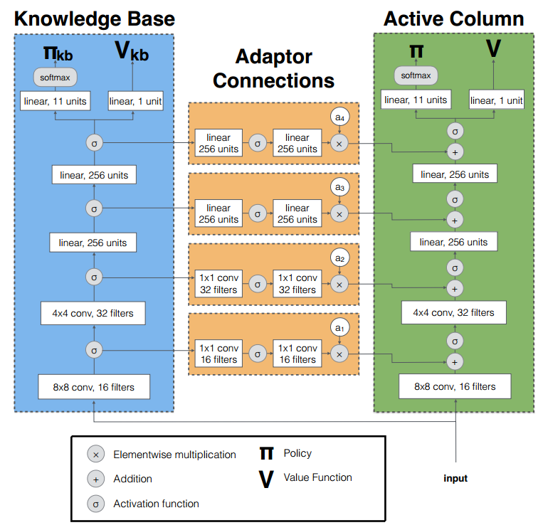
experiments
Computational graph of network
used for experiments in RL

Slide 25
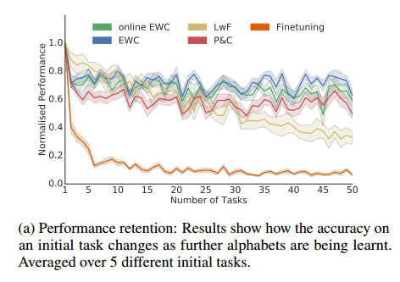
experiments
we aim to answer the following questions:
(i) To what extent is the method affected by catastrophic forgetting?
(ii) Does P&C achieve positive transfer?
(iii) How well does the knowledge base perform across all tasks after learning?
Omniglot dataset
The behaviour of methods designed to overcome catastrophic forgetting

Slide 26
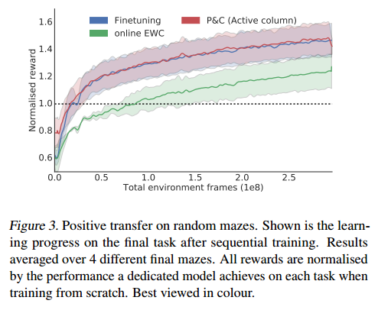
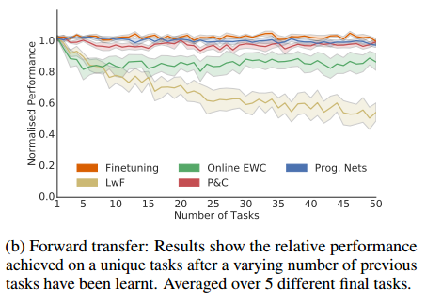
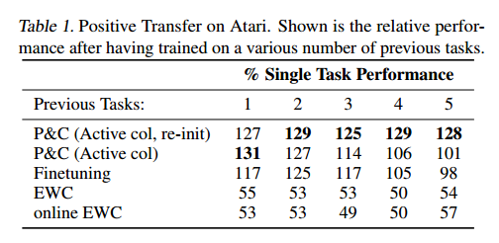
experiments
achieve positive transfer
train on a held-out maze after having visited all 7 previous mazes
more diverse task set
To quantify positive transfer, we record the score after training on a unique task, having visited a varying number of different games beforehand.
Notes:
这个表里面展现的结果是在差异性很大的数据集上面训练得到的 说明在这种情况下funtuniing不利于在新的任务上学习。

Slide 27
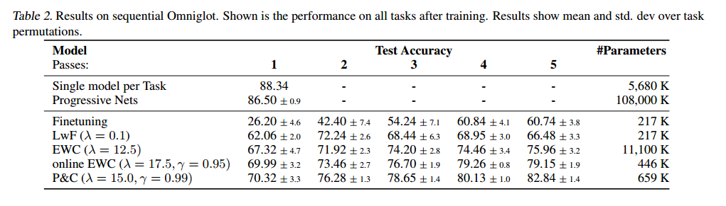
experiments
the overall performance for all methods
Omniglot alphabets
Notes:
1到5是不同的任务顺序

Slide 28
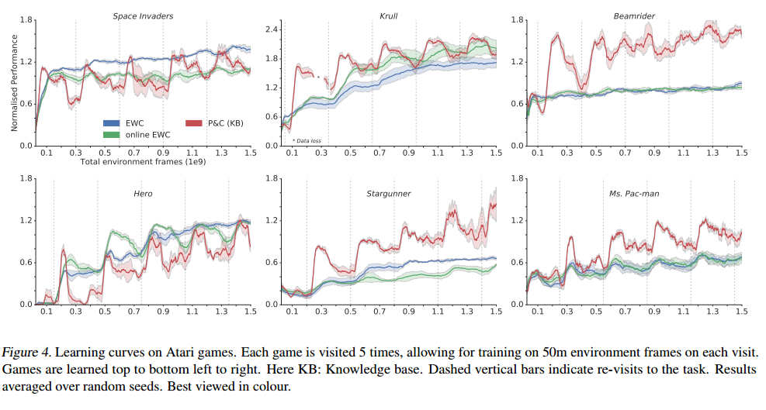
experiments
reinforcement learning on Atari games
In the case of P&C, we only show rewards collected during the compress phase as the parameters remain unchanged when the active column is learning a new task.

